Slide 1
Capstone Engagement
Assessment, Analysis, and Hardening of a Vulnerable System

Slide 2
Table of Contents
This document contains the following sections:
01
Network Topology
02
Red Team: Security Assessment
03
Blue Team: Log Analysis and Attack Characterization
Hardening: Proposed Alarms and Mitigation Strategies
04

Slide 3
Network Topology
3

Slide 4
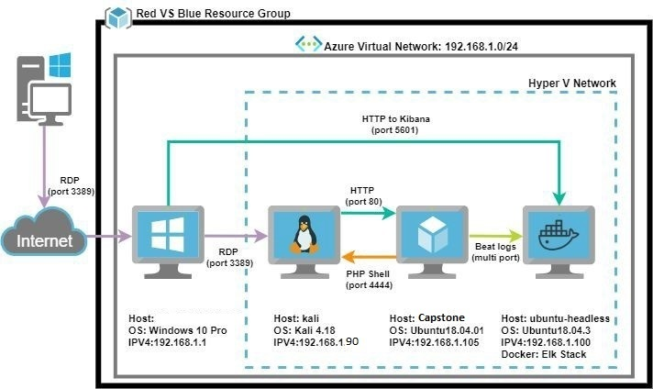
Network Topology
[Insert Here]
Use draw.io to create a diagram of the network.
Add your diagram to this slide and fill out the data in the sidebar.
Network
Address Range:192.168.1.0/24
Netmask: 255.255.255.0
Gateway: 192.168.1.1
Machines
IPv4: 192.168.1.90
OS: Kali 4.18
Hostname: Kali
IPv4: 192.168.1.105
OS: Ubuntu 18.04.01
Hostname: Capstone
IPv4: 192.138.1.100
OS: Ubuntu 18.04.3
Hostname: Elk-Stack

Slide 5

Red Team
Security Assessment
5

Slide 6
Recon: Describing the Target
Nmap identified the following hosts on the network:
Hostname | IP Address | Role on Network
Elk-Stack Server | 192.168.1.100 | Kibana Log Server
Kali VM | 192.168.1.90 | Attacker Machine
Capstone VM | 192.168.1.105 | Vulnerable Machine
Host VM / Azure VM | 192.168.1.1 | Hyper V Manager

Slide 7
Vulnerability Assessment
The assessment uncovered the following critical vulnerabilities in the target:
Vulnerability | Description | Impact
Use the CVE number if it exists. Otherwise, use the common name. | Describe the vulnerability. | Describe what this vulnerability allows the attacker to do.
Sensitive Data Exposure | Found file “Secret_Folder” which was publicly accessible that contained sensitive information | The exposure of this file provided a username and a hash of a password that hackers could use to break into the webserver
Public file uploads | Any user can upload a malicious file to the webserver | Hackers could use this to upload php files that have malicious intent to the webserver
Remote Code Execution via Command Injection | Attackers can execute arbitrary commands once a malicious php file has been uploaded | This provides an opportunity for the hacker to open a reverse shell to the server

Slide 8
Exploitation: Revealing Sensitive Information
01
02
03
Tools & Processes
Nmap to scan ip range
Gobuster to scan website url
The initial browser for further exploration
Hydra for brute forcing a username and password
Achievements
Revealed a file called “secret_folder” which was a directory
The directory was susceptible to a brute force attack via Hydra
Exploitation
A login prompt for user name Ashton
Password was brute forced, revealed password to log into the “secret_folder”

Slide 9
Exploitation: Unauthorized File Upload
01
02
03
Tools & Processes
Cracked credentials to connect to WebDav
Generated a .php file via msfvenom
Uploaded via WebDav
Achievements
Once file was uploaded and executed it allowed the hacker to execute commands on the target system
Aftermath
The meterpreter shell allowed gave a full-connection the server allowing the hacker to execute commands.

Slide 10
Exploitation: Remote Code Execution
01
02
03
Tools & Processes
Meterpreter to connect to a shell created via .php file
Executed commands on the shell to reveal the flag
Achievements
Remote Code Execution allowed a Meterpreter shell to be opened allowing full exploration of the system
Aftermath
After a shell was executed, it allowed access for the full file system to be explored revealing the flag in the root directory.

Slide 11

Blue Team
Log Analysis and Attack Characterization
11

Slide 12
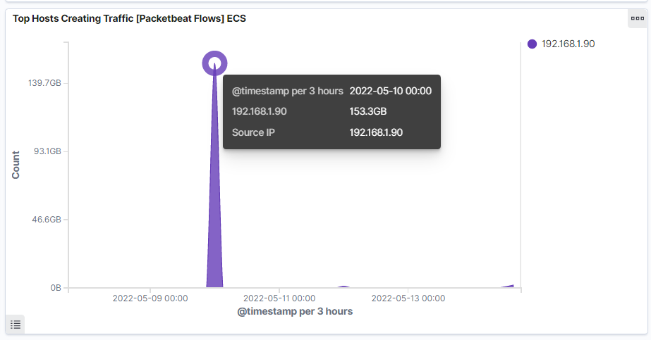
Analysis: Identifying the Port Scan
Notes:
What time did the port scan occur?
05/10/2022 at mid-night

Slide 13
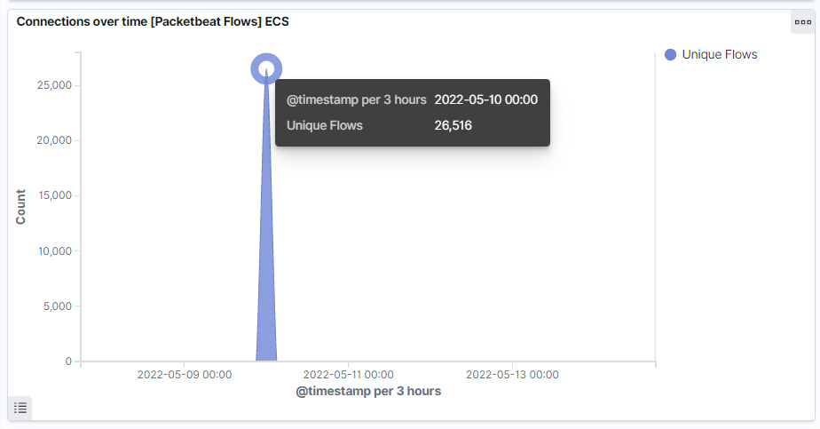
Analysis: Identifying the Port Scan Cont
Notes:
How many packets were sent from IP 192.168.1.90?
26,516

Slide 14
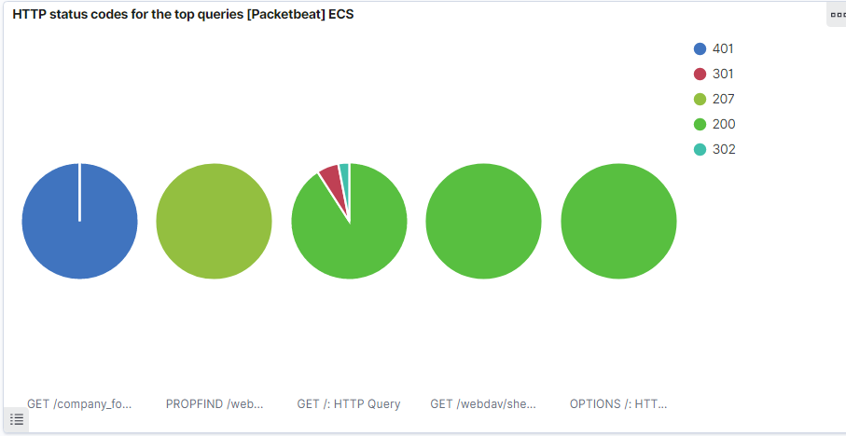
Analysis: Identifying the Port Scan Cont
Notes:
Based on the results the victim responded back with:
401 (unauthorized)
207 (Multi-Status)
200 (OK)
302 (Temporarily Moved)
301 (Moved Permanently)

Slide 15

Analysis: Finding the Request for the Hidden Directory
Answer the following questions in bullet points under the screenshot if space allows. Otherwise, add the answers to speaker notes.
What time did the request occur? How many requests were made?
Which files were requested? What did they contain?
[Insert Here]
Include a screenshot of Kibana logs depicting the request for the hidden directory.
Notes:
What time did the request occur? How many requests were made?
05/10/2022 at mid-night
26,516 requests were made
Which files were requested? What did they contain?

Slide 16
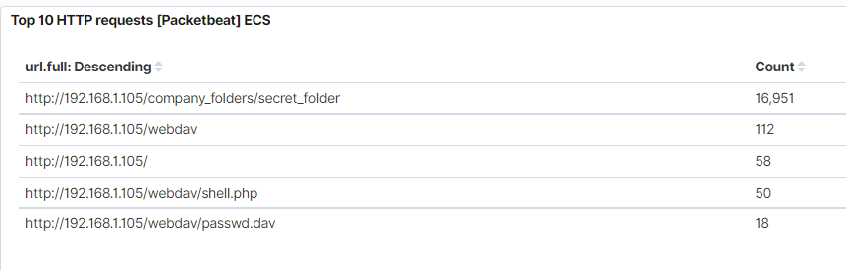
Analysis: Finding the Request for the Hidden Directory Cont
Answer the following questions in bullet points under the screenshot if space allows. Otherwise, add the answers to speaker notes.
What time did the request occur? How many requests were made?
Which files were requested? What did they contain?
[Insert Here]
Include a screenshot of Kibana logs depicting the request for the hidden directory.
Notes:
Which files were requested? What did they contain?
The top 4 files requested were
http://192.168.1.105/company_folders/secret_folder
http://192.168.1.105/webdav
http://192.168.1.105/
http://192.168.1.105/webdav/shell.php

Slide 17
Analysis: Uncovering the Brute Force Attack
Answer the following questions in bullet points under the screenshot if space allows. Otherwise, add the answers to speaker notes.
How many requests were made in the attack?
How many requests had been made before the attacker discovered the password?
[Insert Here]
Include a screenshot of Kibana logs depicting the brute force attack.
Notes:
How many requests were made in the attack?
16,591 requests were made

Slide 18
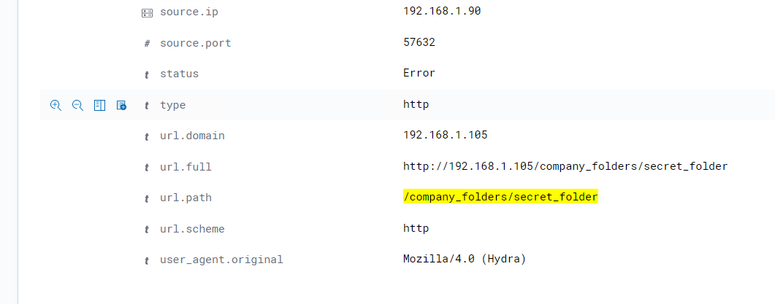
Analysis: Uncovering the Brute Force Attack Cont
Answer the following questions in bullet points under the screenshot if space allows. Otherwise, add the answers to speaker notes.
How many requests were made in the attack?
How many requests had been made before the attacker discovered the password?
[Insert Here]
Include a screenshot of Kibana logs depicting the brute force attack.
Notes:
This indicates Hydra trying to brute force the password

Slide 19
Analysis: Finding the WebDAV Connection
Answer the following questions in bullet points under the screenshot if space allows. Otherwise, add the answers to speaker notes.
How many requests were made to this directory?
Which files were requested?
[Insert Here]
Add a screenshot of Kibana logs depicting the WebDAV connection.
Notes:
How many requests were made to this directory?
112 requests made to the WebDav directory
The Shell.php file was requested
50 times

Slide 20
Blue Team
Proposed Alarms and Mitigation Strategies
20

Slide 21
Mitigation: Blocking the Port Scan
What kind of alarm can be set to detect future port scans? They can be detected by the number of requests per second
What threshold would you set to activate this alarm? An alarm should activate when the threshold is over 10 per second for more than 6 seconds
What configurations can be set on the host to mitigate port scans?
Utilize the firewall where you can throttle the incoming connections
Only whitelisted IP’s should be allowed to ping within the network

Slide 22
Mitigation: Finding the Request for the Hidden Directory
What kind of alarm can be set to detect future unauthorized access?
If a blacklisted or unallowed IP address tries to connect
What threshold would you set to activate this alarm?
Set it to trigger when an unallowed IP is trying to access
What configuration can be set on the host to block unwanted access?
Make sure your file/s is encrypted instead of being plain text
Make sure only allowed users are able to access the file

Slide 23
Mitigation: Preventing Brute Force Attacks
What kind of alarm can be set to detect future brute force attacks?
Set an alarm when the number of login attempts go up per second from a certain user.
What threshold would you set to activate this alarm?
If the threshold exceeds more than 75 per second for more than 5 seconds, it should trigger an alarm.
What configuration can be set on the host to block brute force attacks?
Strong password policy in place
Use a Captcha
Two factor authentication
Have an account lockout policy enabled

Slide 24
Mitigation: Detecting the WebDAV Connection
What kind of alarm can be set to detect future access to this directory?
Make sure your monitoring access with Filebeat
What threshold would you set to activate this alarm?
If anyone tries to access the webdav server have an alert/alarm go off
What configuration can be set on the host to control access?
Make sure you have Filebeat properly configured on the host and is created with administrator privileges.

Slide 25
Mitigation: Identifying Reverse Shell Uploads
What kind of alarm can be set to detect future file uploads?
Different file type is uploaded
What threshold would you set to activate this alarm?
Whenever someone uploads a file
What configuration can be set on the host to block file uploads?
Use a whitelist of allowed file types
The application should use client- or server-side input validation to ensure evasion techniques have not been used to bypass the whitelist filter
Uploaded files should be scanned by an antivirus for malicious content.

